Slide 1

42 Helper
OFFER HELP. REQUEST HELP. HAVE TEST EVALS

Slide 2
...and have fun!

Slide 3
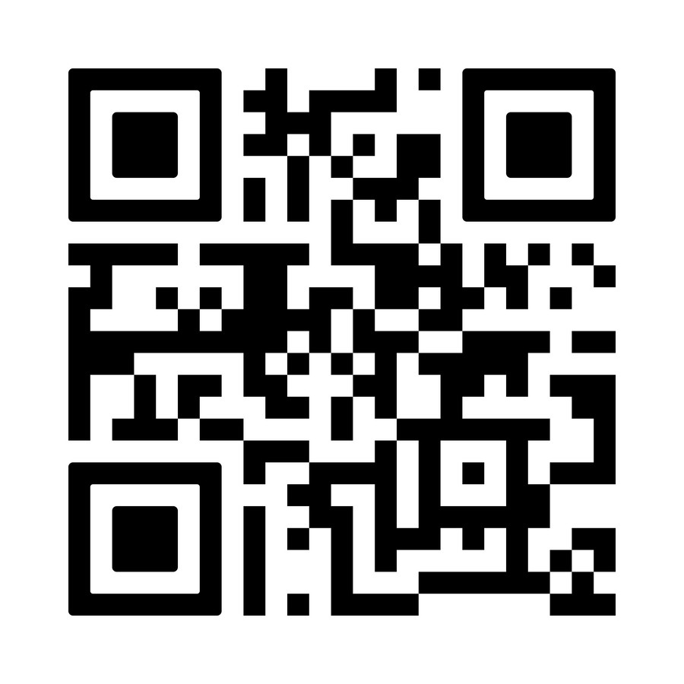
Try it out... it’s already live!
https://42helper.reptudn.uk
PS: .uk was the cheapest

